Slide 1

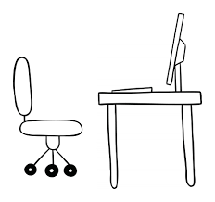

Unveiling sales insights for TechieWorld Superstore’s strategic decisions
Rajashree Hajare

Slide 2
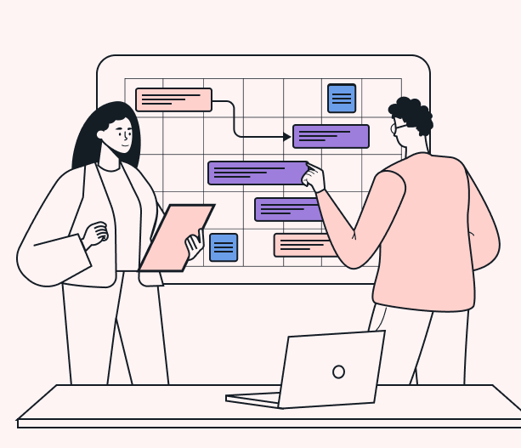
Project Outline
TechieWorld Superstore is an imaginary company providing office essentials to people of United States
The company began in 2010 and since then it has been aggressively advertising to reach its target sales
However, there has been not significant rise in the profit.
Situation: TechieWorld team comes to our company’s data analyst team for support in expand their business.
Problem statement: Dive deep into 4-year sales history dataset and share the insights to help expand their business strategically.

Slide 3
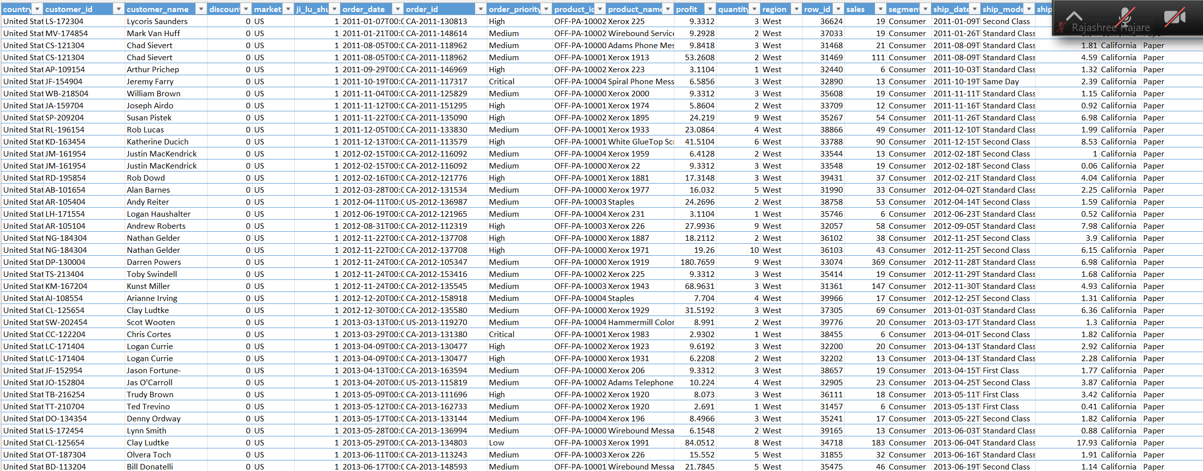
How the original data looked…
Shape : 9994 rows 26 columns
Data types: object / string - 23 columns
integer - 3 columns
Relatively clean data with very few blanks
The most challenging part is the product_name with >1000 possible options

Slide 4
Data wrangling steps
Structuring data : column rename
column rearrangement
changing order_date and shipment_date using Datetime
Cleaning data : remove NaN/ missing data
removing unwanted columns
export cleaned data file to csv
Data verification : confirmed and verified data using google sheets

Slide 5
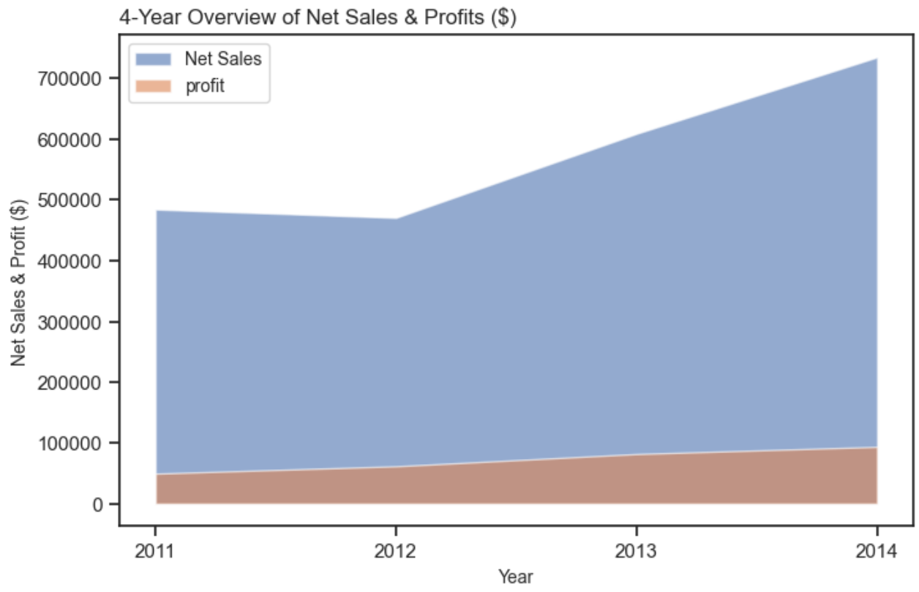
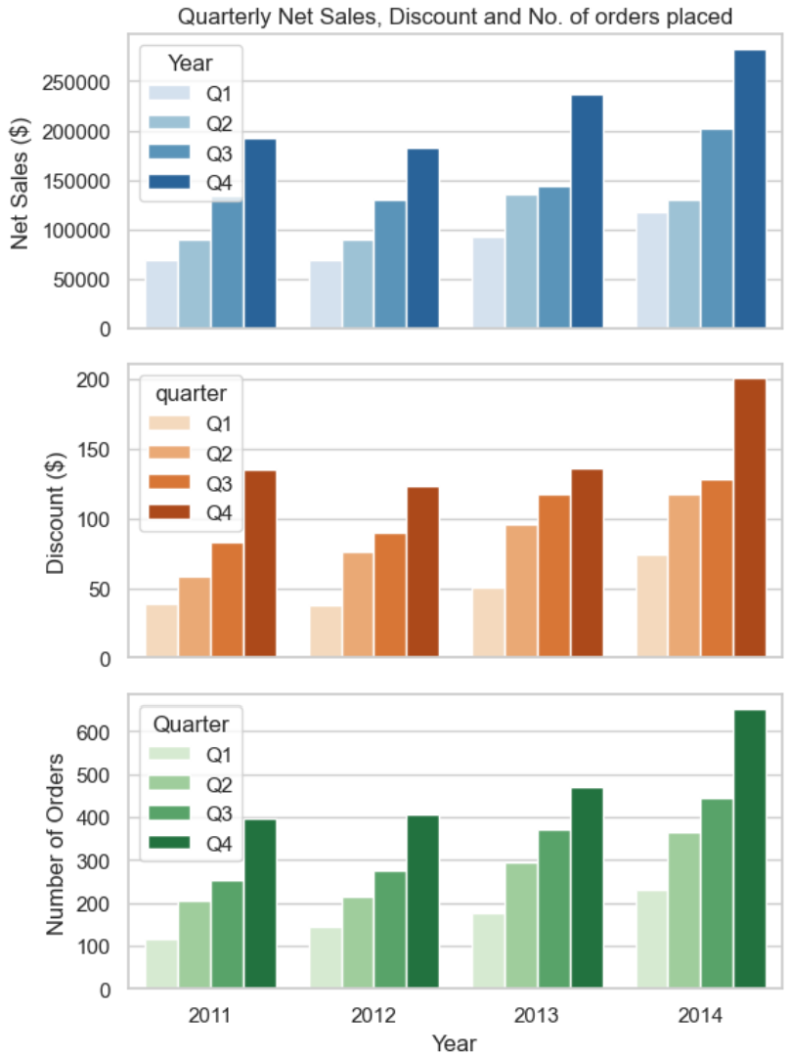
Findings: Annual Performance
Over the 4-years, there is a stead rise in profit and Net Sales
Net Sales shows sudden rise post 2012 but the rise does not seem to correspond with profits
Quarterly variations in Net Sales, Discount and Number of orders place is similar
Q4 – shows highest rise in all 3 categories which is mainly due to festival and/or holiday season. Such seasonality demands for more staff for handling orders and shipment process.

Slide 6
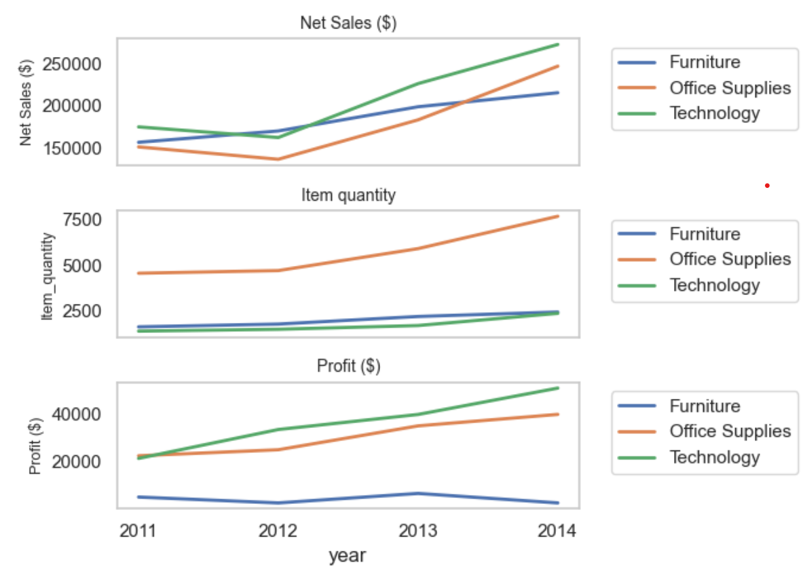
Product Performance
Technology category is the most successful segment, making it strategically important
- highest sales growth and efficacy
- steady demand, implying focus on more advertisement
Office supplies seems to do fairly well in terms of sales but profit is limited
- bulk purchases should be targeted more allowing shipment cost to be reduced
Furniture showed lowest profit and business strategy needs to re-evaluated

Slide 7
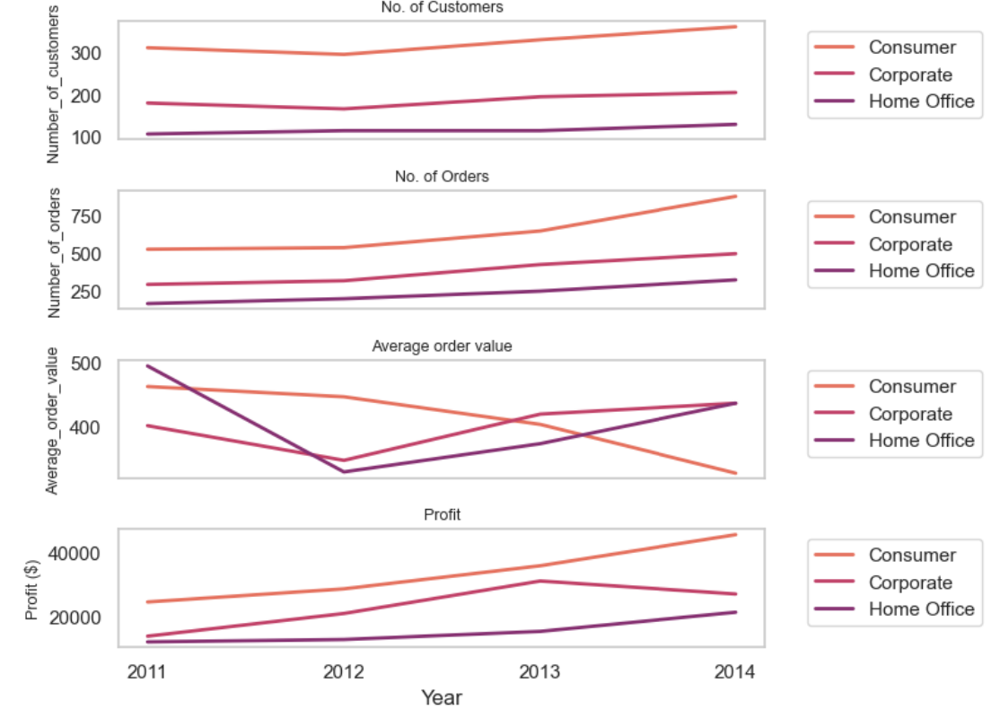
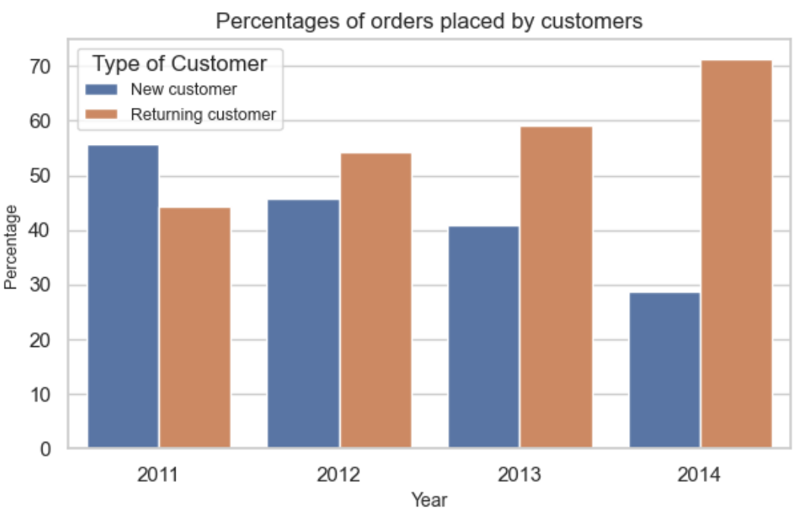
Customer Segmentation
Focus is on type of customers, their preferences, recency and loyalty
In 4 years, there is rise in orders and customers but fall in average order value, indicating supply chain efficiency is critical for success
Fall in rate of new customers indicate:
- re-evaluation of market trends
- update existing product lists
- revise marketing strategies

Slide 8
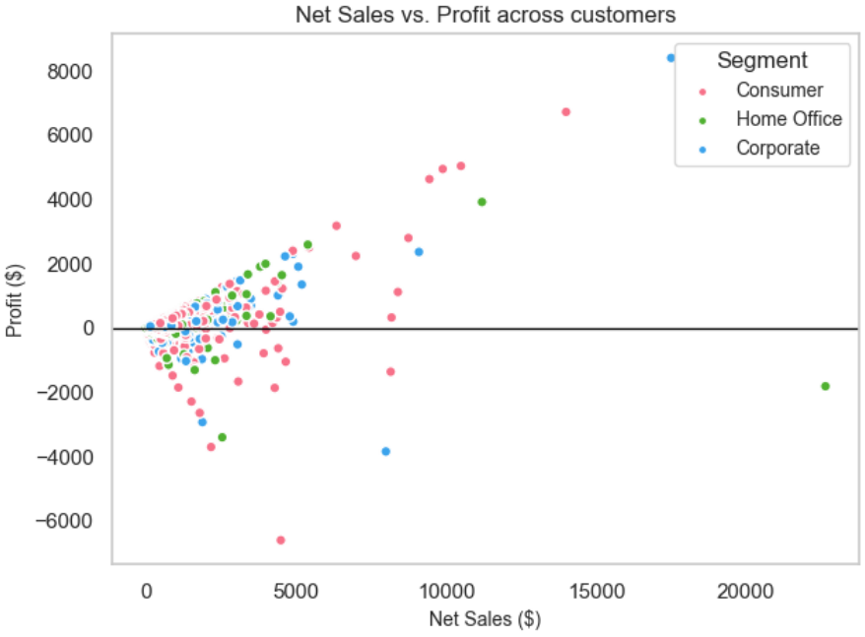
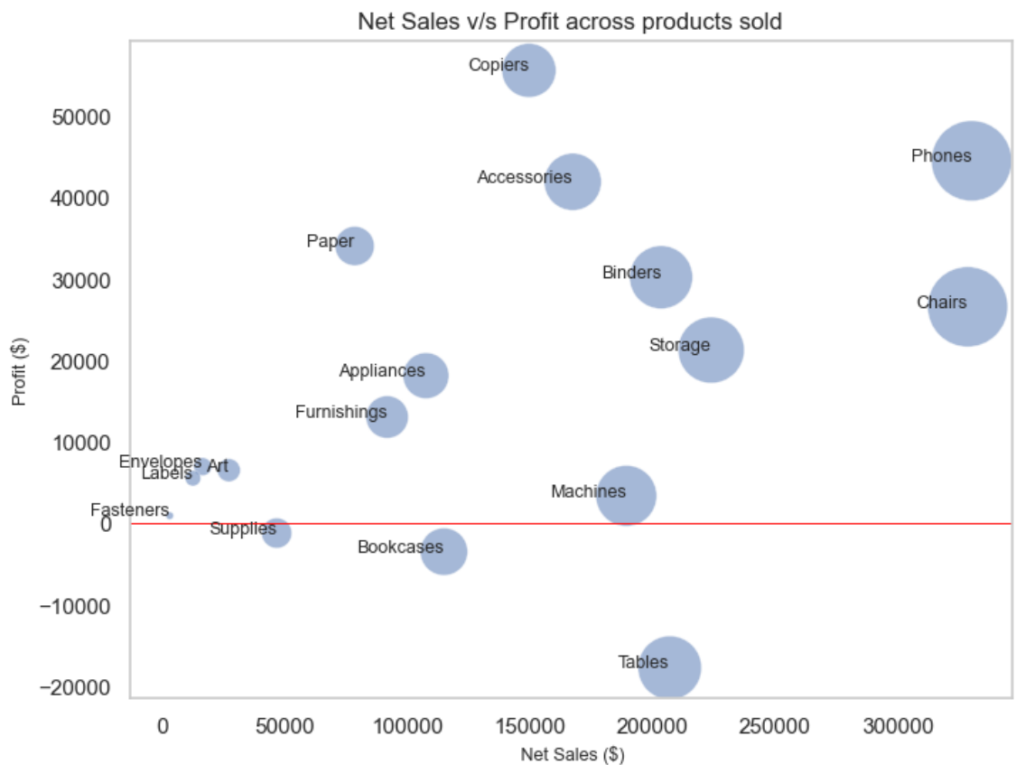
Sales & profits variations across customers and products
Majority customers contribute <5000$ Net sales and < 1500 $ profit
In terms of profit: Furniture : under - performing: Tables* & bookcases; Major contributors : Chairs , furnishings
Office supplies: under - performing : supplies; Major contributors : Copiers
Technology : under - performing : machines*; Major contributors : Phones, Accessories
* Sales seems to be moderate and therefore cost needs to be re-evaluated

Slide 9
Major obstacles
Topic selection and finalization of data set available
Coding…
- defining functions,
- use map or apply ,
- merge or concat or pivot ….
- should I reindex particular column or not
- using visualization tools
Following up with online help available

Slide 10
Demo

Slide 11
Thank you for the attention…

